Slide 1

Introduction to OOPs &Objects - Java
Agenda
Define OOPs
OOP vs Structured Programming
Main Principle of OOP
Objects
Encapsulation
Abstraction
Inheritance
Polymorphism
Java Full Stack Program

Slide 2
Introduction to OOPs &Objects - Java
OOPs
Object-Oriented Programming or OOPs refers to languages that use objects in programming, they use objects as a primary source to implement what is to happen in the code. Objects are seen by the viewer or user, performing tasks assigned by you. Object-oriented programming aims to implement real-world entities like inheritance, hiding, polymorphism etc. in programming.
The main aim of OOP is to bind together the data and the functions that operate on them so that no other part of the code can access this data except that function.
Let us discuss prerequisites by polishing concepts of method declaration and message passing. Starting off with the method declaration, it consists of six components:
Java Full Stack Program

Slide 3
Introduction to OOPs &Objects - Java
OOPs
Access Modifier
It defines the access type of the method i.e., from where it can be accessed in your application. In Java, there are 4 types of access specifiers:
public: Accessible in all classes in your application.
protected: Accessible within the package in which it is defined and, in its subclass(es) (including subclasses declared outside the package).
private: Accessible only within the class in which it is defined.
default (declared/defined without using any modifier): Accessible within the same class and package within which its class is defined.
.
Java Full Stack Program

Slide 4
Introduction to OOPs &Objects - Java
OOPs
The return type: The data type of the value returned by the method or void if it does not return a value.
Method Name: The rules for field names apply to method names as well, but the convention is a little different.
Parameter list: Comma-separated list of the input parameters that are defined, preceded by their data type, within the enclosed parentheses. If there are no parameters, you must use empty parentheses ().
Exception list: The exceptions you expect the method to throw. You can specify these exception(s).
Method body: It is the block of code, enclosed between braces, that you need to execute to perform your intended operations.
Message Passing: Objects communicate with one another by sending and receiving information to each other. A message for an object is a request for execution of a procedure and therefore will invoke a function in the receiving object that generates the desired results. Message passing involves specifying the name of the object, the name of the function and the information to be sent.
.
Java Full Stack Program

Slide 5
Introduction to OOPs &Objects - Java
Structured Programming vs OOPs
Structured Programming | Object-Oriented Programming
Programs are divided into small programs or functions. | Programs are divided into objects or entities.
It is all about facilitating creation of programs with readable code and reusable components. | It is all about creating objects that usually contain both functions and data.
Its main aim is to improve and increase quality, clarity, and development time of computer program. | Its main aim is to improve and increase both quality and productivity of system analysis and design.
It simply focuses on functions and processes that usually work on data. | It simply focuses on representing both structure and behavior of information system into tiny or small modules that generally combines data and process both.
It is a method of organizing, managing and coding programs that can give or provide much easier modification and understanding. | It is a method in which set of objects can vary dynamically and can execute just by acting and reading to each other.
In this, methods are written globally, and code lines are processed one by one i.e., Run sequentially. | In this, method works dynamically, make calls as per need of code for certain time.
It generally follows “Top-Down Approach”. | It generally follows “Bottom-Up Approach”.
Java Full Stack Program

Slide 6
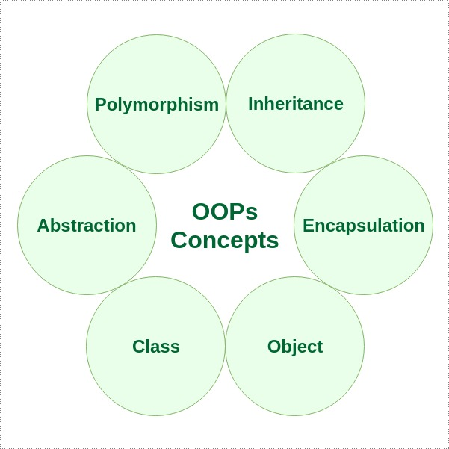
Introduction to OOPs &Objects - Java
Main Principle of OOPs
OOPS concepts are as follows:
Class
Object
Method and method passing
Pillars of OOPs
Abstraction
Encapsulation
Inheritance
Polymorphism
Compile-time polymorphism
Runtime polymorphism
Java Full Stack Program

Slide 7
Introduction to OOPs &Objects - Java
Class
A class is a user-defined blueprint or prototype from which objects are created.
It represents the set of properties or methods that are common to all objects of one type. Using classes, you can create multiple objects with the same behavior instead of writing their code multiple times.
This includes classes for objects occurring more than once in your code. In general, class declarations can include these components in order:
Java Full Stack Program

Slide 8
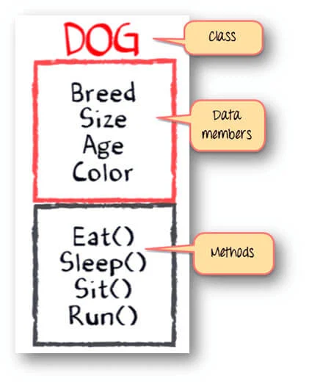
Introduction to OOPs &Objects - Java
Modifiers: A class can be public or have default access.
Class name: The class name should begin with the initial
letter capitalized by convention.
3. Superclass (if any): The name of the class’s parent (superclass),
if any, preceded by the keyword extends.
A class can only extend (subclass) one parent.
4.Interfaces (if any): A comma-separated list of interfaces
implemented by the class, if any, preceded by the
keyword implements. A class can implement more than one interface.
5. Body: The class body is surrounded by braces, { }.
Java Full Stack Program

Slide 9
Introduction to OOPs &Objects - Java
Objects
An object is a basic unit of Object-Oriented Programming that represents real-life entities. A typical Java program creates many objects, which as you know, interact by invoking methods. The objects are what perform your code, they are the part of your code visible to the viewer/user. An object mainly consists of:
State: It is represented by the attributes of an object. It also reflects the properties of an object.
Behavior: It is represented by the methods of an object. It also reflects the response of an object to other objects.
Identity: It is a unique name given to an object that enables it to interact with other objects.
Method: A method is a collection of statements that perform some specific task and return the result to the caller. A method can perform some specific task without returning anything. Methods allow us to reuse the code without retyping it, which is why they are considered time savers.
Java Full Stack Program

Slide 10
Introduction to OOPs &Objects - Java
Abstraction
What is Abstraction?
Abstraction is the process of hiding the internal details of an application from the outer world. Abstraction is used to describe things in simple terms. It’s used to create a boundary between the application and the client programs.
2. Abstraction in Real Life
Abstraction is present in almost all the real-life machines.
Your car is a great example of abstraction. You can start a car by turning the key or pressing the start button. You don’t need to know how the engine is getting started, what all components your car has. The car internal implementation and complex logic is completely hidden from the user.
We can heat our food in Microwave. We press some buttons to set the timer and type of food. Finally, we get a hot and delicious meal. The microwave internal details are hidden from us. We have been given access to the functionality in a very simple manner.
3. Abstraction in OOPS
Objects are the building blocks of Object-Oriented Programming. An object contains some properties and methods. We can hide them from the outer world through access modifiers. We can provide access only for required functions and properties to the other programs. This is the general procedure to implement abstraction in OOPS.
Java Full Stack Program

Slide 11
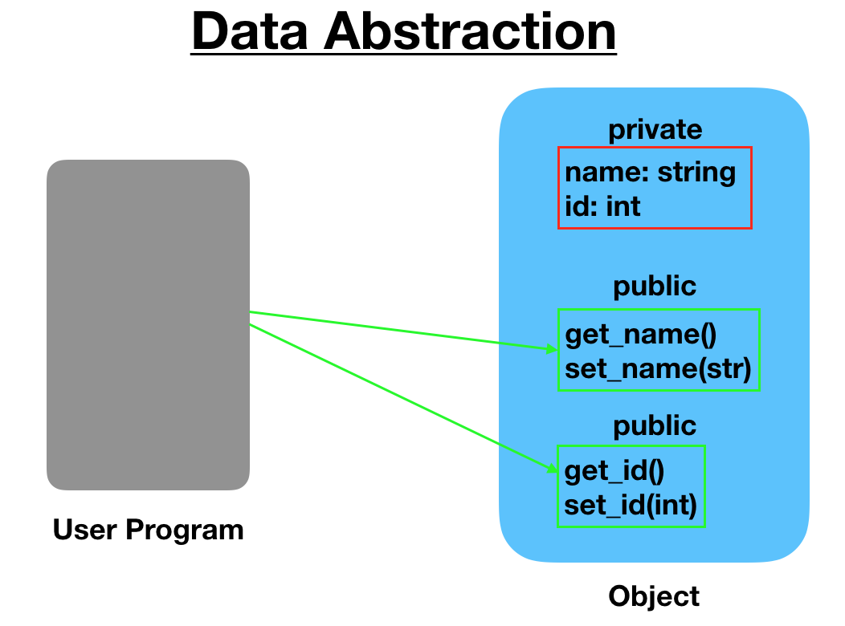
Introduction to OOPs &Objects - Java
Abstraction
What are the different types of abstraction?
There are two types of abstraction.
Data Abstraction
Process Abstraction
4.1) Data Abstraction
When the object data is not visible to the outer
world, it creates data abstraction.
If needed, access to the Objects’ data is
provided through some methods.
Java Full Stack Program

Slide 12
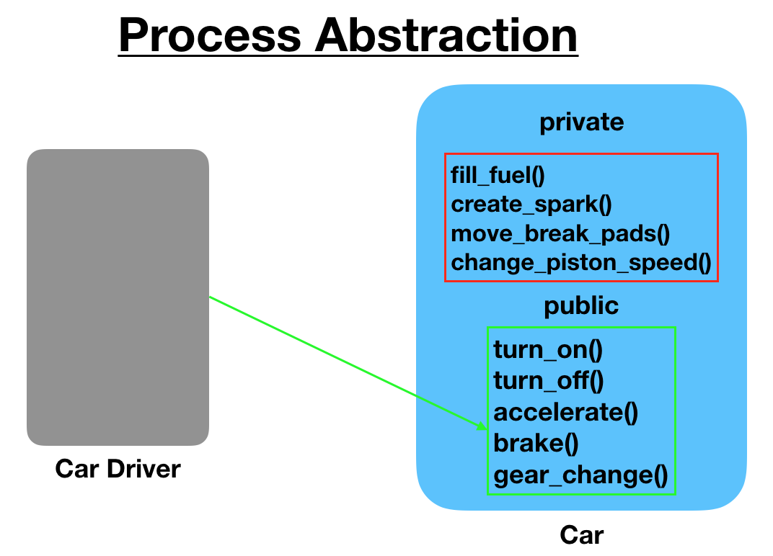
Introduction to OOPs &Objects - Java
Abstraction
4.2) Process Abstraction
We don’t need to provide details about all the
functions of an object.
When we hide the internal implementation of
the different functions involved in a
user operation, it creates process abstraction.
Java Full Stack Program

Slide 13
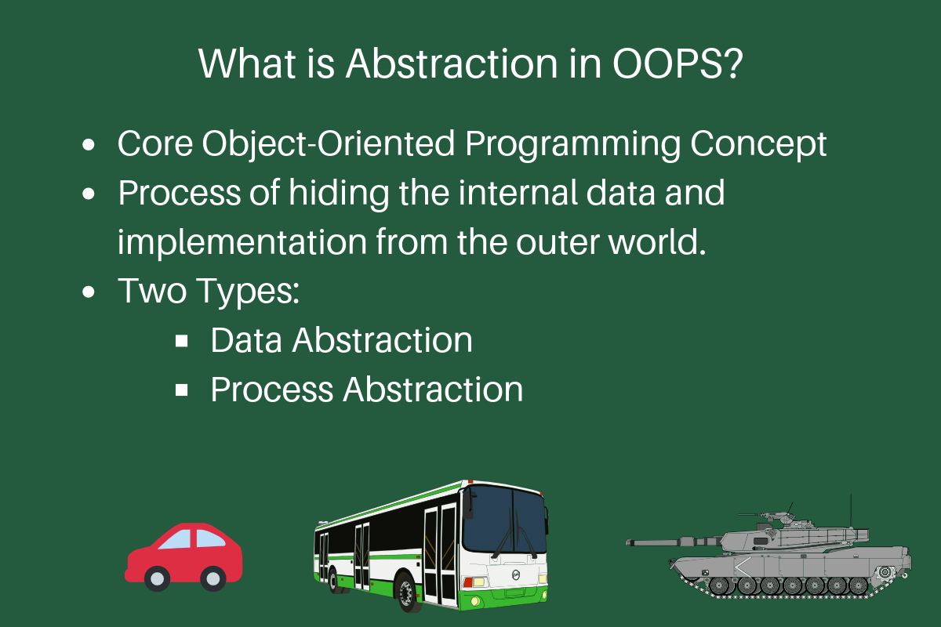
Introduction to OOPs &Objects - Java
Abstraction
5. Abstraction in Java
Abstraction in Java is implemented through interfaces and abstract classes. They are used to create a base implementation or contract for the actual implementation classes. Car.java: Base interface or abstract class
Java Full Stack Program

Slide 14
Introduction to OOPs &Objects - Java
Abstraction
Abstract Classes and Methods
Data abstraction is the process of hiding certain details and showing only essential information to the user. Abstraction can be achieved with either abstract classes or interfaces (which you will learn more about in the next chapter).
The abstract keyword is a non-access modifier, used for classes and methods:
Abstract class: is a restricted class that cannot be used to create objects (to access it, it must be inherited from another class).
Abstract method: can only be used in an abstract class, and it does not have a body. The body is provided by the subclass (inherited from).
Java Full Stack Program

Slide 15
Introduction to OOPs &Objects - Java
Encapsulation
The process of wrapping data and functions that perform actions on the data into a single entity is known as encapsulation. A single unit is referred to as a class. Encapsulation is the process of encapsulating something in a capsule. That is, confining all an object's relevant activities and data within that object. It protects the data and code from outside intervention.
One of the fundamentals of OOPs is encapsulation. It refers to the combination of data and procedures that operate on it. A technique for limiting unauthorized access to the values or state of a structured data object within a class. To access the values, the class usually provides publicly accessible methods (so-called getters and setters), which other client classes call to retrieve and modify the values within the object.
Java Full Stack Program

Slide 16
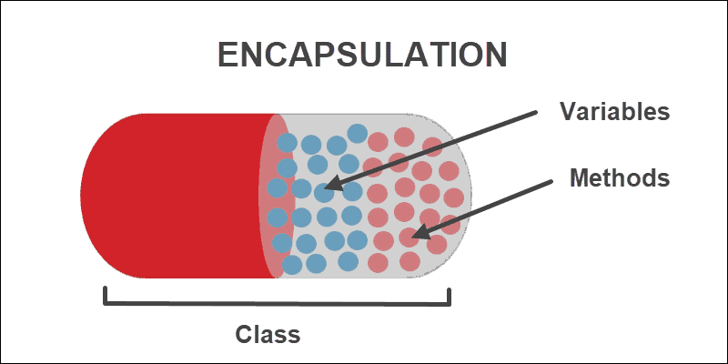
Introduction to OOPs &Objects - Java
Encapsulation
The main purpose or usage of encapsulation is to guarantee security for a class's data.
To secure the data, we must employ private access modifiers, which limit access to the data outside of the class. Access modifiers are used to specify the level of access or scope of class members such as data members and functions.
Java Full Stack Program

Slide 17
Introduction to OOPs &Objects - Java
Encapsulation
The main purpose or usage of encapsulation is to guarantee security for a class's data. To secure the data, we must employ private access modifiers, which limit access to the data outside of the class. Access modifiers are used to specify the level of access or scope of class members such as data members and functions.
Encapsulation is advantageous for various reasons:
External code in a separate portion of our application does not change data inside our object in an unanticipated way
Functionality is described in a single location rather than multiple locations
It is defined in a logical location - the data storage location
Java Full Stack Program

Slide 18
Introduction to OOPs &Objects - Java
Inheritance
Inheritance is an important pillar of OOP (Object Oriented Programming). It is the mechanism in Java by which one class is allowed to inherit the features (fields and methods) of another class.
Let us discuss some frequently used important terminologies:
Superclass: The class whose features are inherited is known as superclass (also known as base or parent class).
Subclass: The class that inherits the other class is known as subclass (also known as derived or extended or child class). The subclass can add its own fields and methods in addition to the superclass fields and methods.
Reusability: Inheritance supports the concept of “reusability”, i.e. when we want to create a new class and there is already a class that includes some of the code that we want, we can derive our new class from the existing class. By doing this, we are reusing the fields and methods of the existing class.
Java Full Stack Program

Slide 19
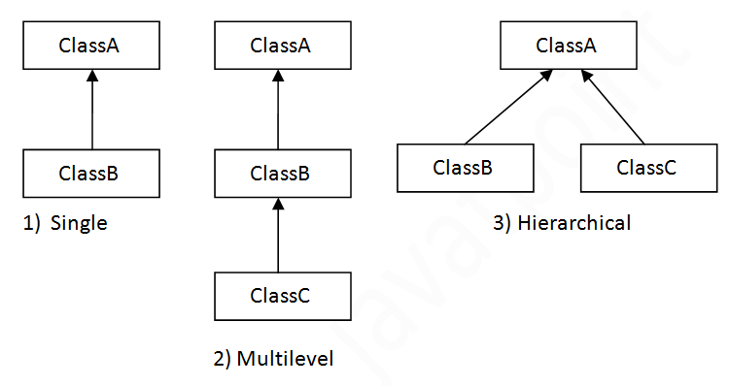
Introduction to OOPs &Objects - Java
Types of Inheritance
Java Full Stack Program

Slide 20
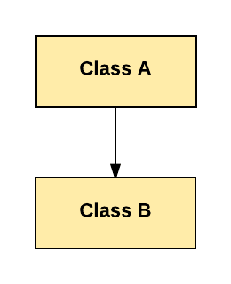
Introduction to OOPs &Objects - Java
Types of Inheritance
Here are the different types of inheritance in Java:
Single Inheritance:
In Single Inheritance one class extends another class (one class only).
Java Full Stack Program

Slide 21
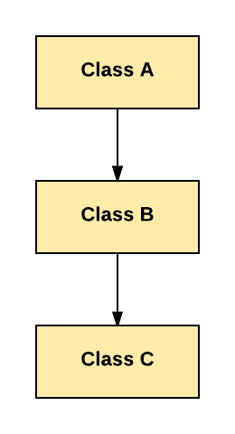
Introduction to OOPs &Objects - Java
.
Multilevel Inheritance
In Multilevel Inheritance, one class can inherit from a derived class. Hence, the derived class becomes the base class for the new class.
Java Full Stack Program

Slide 22
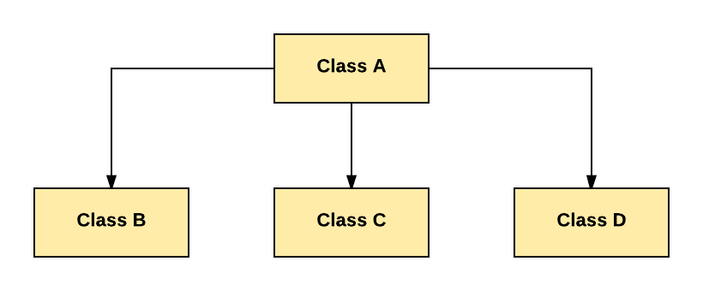
Introduction to OOPs &Objects - Java
.
Hierarchical Inheritance:
In Hierarchical Inheritance, one class is inherited by many sub classes.
Java Full Stack Program

Slide 23
Introduction to OOPs &Objects - Java
Advantages of Inheritance
Inheritance promotes reusability. When a class inherits or derives another class, it can access all the functionality of inherited class.
Reusability enhanced reliability. The base class code will be already tested and debugged.
As the existing code is reused, it leads to less development and maintenance costs.
Inheritance makes the sub classes follow a standard interface.
Inheritance helps to reduce code redundancy and supports code extensibility.
Inheritance facilitates creation of class libraries.9
Java Full Stack Program

Slide 24
Introduction to OOPs &Objects - Java
Polymorphism
Every object-oriented programming language must include the fundamental concept of polymorphism, which is inseparable from OOPs. An object or reference can have distinct forms in various contexts. Polymorphism would be defined as "a property of having numerous forms" since, as the name suggests, "poly" denotes "many," and "morph" refers to "forms."
A single interface in the object-oriented programming language handles both classes and objects. It puts virtual functions, overriding, and function overloading into practice. Additionally, it is frequently employed in programming to instrument inheritance.
One of the important OOPS ideas is polymorphism. You can have different or numerous kinds of objects and variables or use polymorphism methods. Polymorphism allows for different implementations of the same method depending on the requirements of the class.
Java Full Stack Program

Slide 25
Introduction to OOPs &Objects - Java
Examples of Polymorphism
A person performs the roles of a worker at work, a father at home, and a shopper at malls.
2. A security guard outside the organization behaves differently when different people enter. When the boss shows up, he behaves in one way, and when the employees show up, he behaves differently.
3. Assume that when you are in a classroom, you act like a student; when you are in a store, you act like a consumer; and when you are at home, you act like a son or daughter. One person is visible here, acting in various ways. Assume that when you are in a classroom, you act like a student, when you are in a store, you act like a consumer, and when you are at home, you act like a son or daughter, One person is visible here, acting in various ways.
Java Full Stack Program

Slide 26
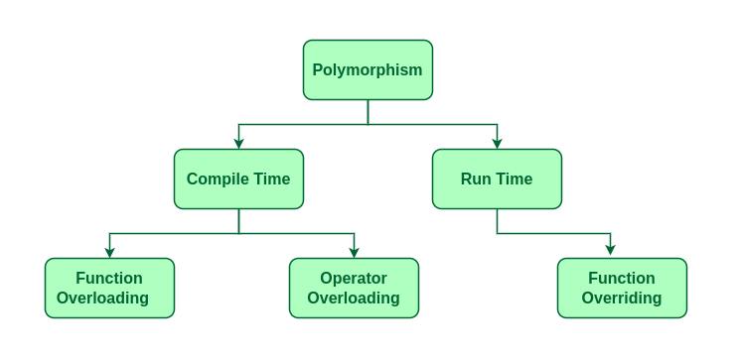
Introduction to OOPs &Objects - Java
Java Full Stack Program

Slide 27
Introduction to OOPs &Objects - Java
There are two types of polymorphism in OOPs:
Static
Dynamic
1. Static Polymorphism
In object-oriented programming polymorphism languages, one can achieve static
polymorphism by employing the overloading technique. The programmer would be able to use a variety of ways with this approach. Despite sharing names, they have different parameters. Overloading methods are an example of static polymorphism.
Static polymorphism requires a few certain criteria to exist. As follows:
The kinds of each parameter would need to be distinct.
It's possible that the parameter's order needs to change.
One method would need to have a different set of parameters than the other method.
Java Full Stack Program

Slide 28
Introduction to OOPs &Objects - Java
2. Dynamic Polymorphism
Another name for this procedure is runtime polymorphism. Under this procedure, a single call to an overridden method is resolved while the application is running. The best example of runtime polymorphism is method overriding, where the compiler does not handle the call.
Using pointers and virtual functions, overriding is accomplished. The act of declaring a single method in a subclass that is already existent in the parent class is known as method overriding. The kid class would acquire a method for implementation through this approach. The parent class of the child class provides this function.
Although this polymorphism process is slower than static polymorphism, it is more versatile.
Without altering or changing the codes of the parent class object, it is feasible to transfer one method's implementation to another. As a result, if one child class requires the parent class implementation method while another child class may use the overriding feature to have an alternative implementation method.
Java Full Stack Program

Slide 29
Introduction to OOPs &Objects - Java
Difference Between Compile Time And Runtime Polymorphism
1. Compile Time Polymorphism
Compile-time polymorphism occurs whenever an object is associated with its functionality at the moment of compilation. By examining the method signatures, OOPs determine the method to call at compile time. Compile-time polymorphism, static polymorphism, or early binding are all terms for this. Method overloading is used to achieve compile-time polymorphism. According to method overloading, a class may contain many functions with the same name but different prototypes. One technique to create polymorphism is through function overloading. However, this depends on the technology used and the kind of polymorphism chosen.
2. Runtime Polymorphism
Runtime polymorphism is the process of binding an object to functionality during runtime. Method overriding can be used to achieve runtime polymorphism. It is also known as late binding or dynamic binding. According to the concept of method overriding, the parent class's method is overridden in the child class. This indicates that method overriding occurs when a child class provides a specific implementation of a method that was given by one of its parent classes.
Java Full Stack Program

Slide 30
Introduction to OOPs &Objects - Java
Advantages of Using Polymorphism
It helps the programmer reprocess the source code. It entails that previously written codes and classes that have been verified and executed can be reused as needed, saving a programmer's time. Thus, these codes and associated classes may be applicable to several additional techniques.
Only one variable can be used for storing several data types, such as Int, Float, Double, Long, etc.. It makes it simpler to look for and use these kinds of variables that users use.
Simple code debugging.
It aids in preserving and reducing the connectivity between different functionalities.
Gives programmers the freedom to create programs that, depending on the situation, employ just one technique for numerous executions.
One of its biggest benefits is that it enables programming code to grow and use the previous program, saving time and work for developers.
The fundamental idea behind OOPs languages, this technique is also used to program many kinds of large-scale code execution.
This polymorphism feature makes it possible for programmers to create codes more quickly and creatively.
Java Full Stack Program

Slide 31
Introduction to OOPs &Objects - Java
THANK YOU !
Java Full Stack Program

